Slide 1
ADVANCED STATISTICS

Slide 2
ADVANCED STATISTICS TOPICS
Hypothesis Tests for large samples: z-score
Confidence Intervals
Hypothesis Test for small samples: t-score

Slide 3
HYPOTHESIS TESTING
General Logic of Hypothesis Testing (Logic of Opposites)
We hope to demonstrate that something is meaningful. To do so, we assume it is not meaningful and proceed to refute that assumption. Since there are only two possibilities, the alternative, “it is meaningful”, must be true.
Example:
We assume the Null Hypothesis: The true mean is = 0.
The Alternative Hypothesis is: The true mean is not =0.
We allow for a 5% chance that we might be wrong. From a previous slide, the value of Z such that 5% of the
area is to the right of Z is 1.645. That is the critical Z.
Calculate the Z-score for the given data’s mean, assuming the true mean is zero.
4. If calculated Z is > critical Z, that event is “highly unlikely to occur”, so the true mean must not be =0.
If calculated Z is < critical Z, we can’t conclude that the true mean is not =0.

Slide 4
ONE-TAIL HYPOTHESIS TEST FOR THE MEAN
Example: The Countrywide Cost of a Total Loss claim is $21,000. A sample of 100 Total Loss claims from Virginia has a sample mean of $23,170 and a sample SD of $7,000. Is Virginia’s true mean greater than $21,000 at the p=0.05 level of significance?
Null Hypothesis: VA true mean = 21,000.
Alternative Hypothesis: VA true mean > 21,000.
2. This is 1-tail because we want to know if it is “greater than”. Critical Z is 1.64.
3. SD(mean) = [7000/SQRT(100)] = 7000/10 = 700
4. The calculated Z-score is [23,170-21,000] / [SD(mean)] = 2170 / 700 = 3.1
5. Since 3.1 > 1.64, it is “highly unlikely” VA true mean is 21,000. We conclude the VA true mean is >21,000.
What If n=25? SD(mean)=7000/(sqrt(25)) = 1400. Z-score=2170/1400=1.55. Cannot reject the null hypothesis

Slide 5
TWO-TAIL HYPOTHESIS TEST FOR THE MEAN
Example: The average annual PTO time for the last 5 years in Claims has been 3.0 weeks. A sample of 100 PTO records for the current year-to-date has a sample mean of 2.75 weeks and a sample SD of 2 weeks. Is this year’s true mean different than the historical 3 weeks at the p=0.05 level of significance?
Null Hypothesis: the true mean this year is = 3
Alternative Hypothesis: the true mean this year is not = 3.
2. This is 2-tail because “different from” could be positive or negative. The Critical Zs are -1.96 and +1.96.
3. SD(mean) = [2/SQRT(100)] = 2/10 = 0.2
4. The calculated Z-score is [2.75-3] / [SD(mean)] = -0.25/0.2 = -0.125
5. Since -0.125 > -1.96, we cannot reject the null hypothesis that this year’s true mean is 3 weeks..

Slide 6
HYPOTHESIS TESTING
Khan Academy
Hypothesis Testing
Notes:
https://www.khanacademy.org/math/statistics-probability/significance-tests-one-sample/more-significance-testing-videos/v/hypothesis-testing-and-p-values

Slide 7
95% CONFIDENCE INTERVALS
We are 95% confident the true mean is within that interval.
Example: Roadway Service Cost in Pennsylvania
What is a 95% CI for the true mean if the Sample Mean = 41, Sample SD = 15, and the sample size = 25?
1. The sample mean is normally distributed. A 95% interval is the Sample Mean plus/minus 1.96 x SD(mean).
2. The SD(mean) is SD(sample)/SQRT(n) = 15/SQRT(25) = 15/5 = 3
3. A 95% CI in which the true mean lies is 41-(1.96)(3) to 41+(1.96)(3) = 35.1 to 46.9
If a 95% confidence interval for the mean does not include zero, that is equivalent to a Hypothesis Test with p=0.05 rejecting the null hypothesis that mean=0. In my opinion, it is easier to run and explain.

Slide 8
CONFIDENCE INTERVALS
Khan Academy
Confidence Intervals
Notes:
https://www.khanacademy.org/math/ap-statistics/xfb5d8e68:inference-categorical-proportions/introduction-confidence-intervals/v/confidence-intervals-and-margin-of-error

Slide 9
A/B TESTING RELATIONSHIP TO CONFIDENCE INTERVALS
In A/B testing, we usually have a very large sample size. For example, in the earlier A/B presentation, the sample size was 64,000. The SQRT(64,000) is 253.
The SD(mean) will be extremely small if the SD(sample) is divided by 253. The CI will then also be extremely small. So small that for all practical purposes you can treat the results as being “exact”.
So, the values you got (below) can be treated as exact numbers when making the A vs. B comparison and you don’t need to compute confidence intervals around the averages.
51.2% for the average of A
51.7% for the average of B

Slide 10
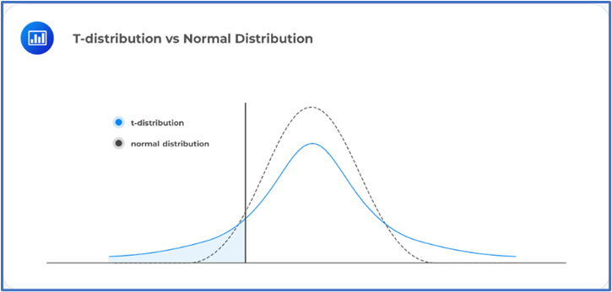
Hypothesis Test for Small Data: t-Test
Notes:
https://www.khanacademy.org/math/ap-statistics/xfb5d8e68:inference-quantitative-means/one-sample-t-interval-mean/v/introduction-to-t-statistics

Slide 11
Hypothesis Test for Small Data: t-Test
A t-test is run the same way as a z-test but is used for small sample size.
Ex: Hailstone size in KS
A sample of size n=9 has a Sample Mean=6.4 inches and a sample SD=12. Is the true mean different from 4 inches (last year’s value) at the p=0.05 level of significance?
1. From the t-table, the 95% critical value of t for a sample of size 9 [(n-1)=8 df] , is 2.306 (larger than z=1.96)
2. SD of the mean = 12/SQRT(9) = 12/3 = 4
3. t-score = (6.4 – 4)/4 = 2.4/4 = 0.60, which is less than 2.306.
We cannot say the true mean is different from 4
Notes:
https://www.khanacademy.org/math/ap-statistics/xfb5d8e68:inference-quantitative-means/one-sample-t-interval-mean/v/introduction-to-t-statistics

Slide 12
EXCEL EXERCISES
Go to the Excel exercises in your workbook. The answers are to the far right on each tab.
Tabs
HypTest
ConfInt
tDist

Slide 13
COURSE GOALS REVISITED
Demonstrate a basic knowledge of Analytics related Algebra concepts.
Demonstrate an understanding of basic Statistics knowledge.
Notes:
Through Advanced Topics section (00:35)
Outro:
During this week, our goals were to demonstrate a basic knowledge of algebra concepts and to have an understanding of statistics knowledge to help you in your analytical role.
Keep in mind that we have squashed a semester’s worth of material to one week. You are not expected to be an expert. The ideas of statistics expand much further. In fact, there are people that major in statistics! Keep an open, learning mind and you’ll be applying statistics without a second thought!

Slide 14
POST-TEST
2 X 2 + 2 X 2 = 4 + 4 = 8
Rebase the series to the last number: 5, 7, 15, 12, 6 0.83, 1.17, 2.5, 2.0, 1.0
What are the first 2 terms of a MA2 for the series above: (5+7)/2, (7+15)/2 = 6, 11
The average is a measure of the central tendency of a set of data.
The standard deviation is a measure of how compact or spread out the data is
Given a Normal Distribution with mean=100 and standard deviation=15, what are the Z-scores that include 95% of the data values? [70, 130]
Explain the Central Limit Theorem? No matter what the distribution of a set of data, the mean of that set of data has a normal distribution.
Advanced
Given a data set of 15 values, and we want to conduct a hypothesis test on the mean, should we use the z-score or t-score? __
The most common level of significance used for Confidence Intervals is: ____

Slide 15
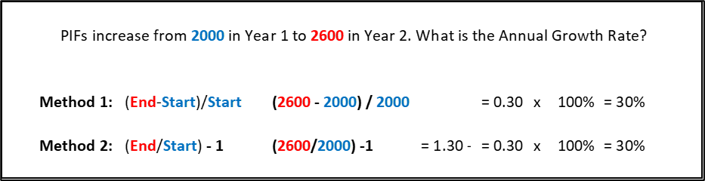
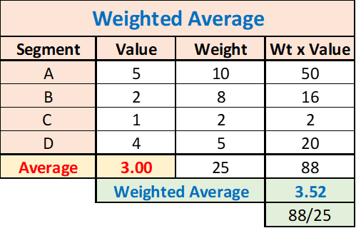
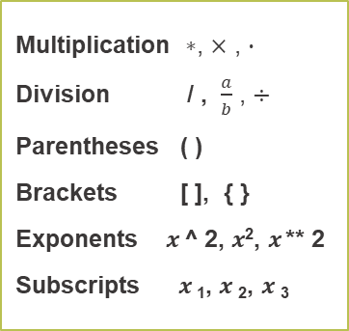
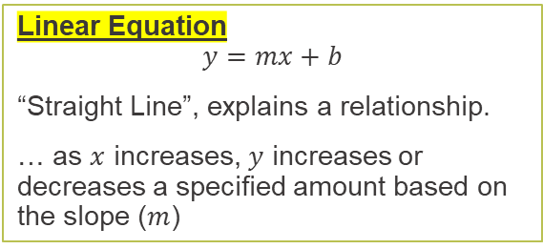
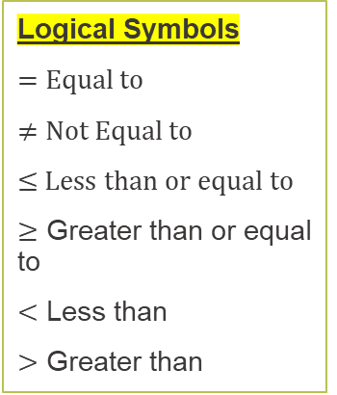
ALGEBRA ON A PAGE
Multiplication $∗$, $×$ , $∙$
Division / , $\frac{a}{b}$ , $÷$
Parentheses ( )
Brackets [ ], { }
Exponents $x$ ^ 2, $x$², $x$ ** 2
Subscripts $x$₁, $x$₂, $x$₃
Rebasing & Relativities
The act of dividing by a “base” or “reference” level is known as rebasing. This process is often used to create easy to digest measures called relativities. It is common to see analyses report measures such as “Loss Ratio Relativities” or “Pure Premium Relativities”.
Orders of Magnitude & Scaling
Explicitly display or represent the scaling base
When conducting analysis, be mindful of scaled variables
Logical Symbols
$=$ Equal to
$≠$ Not Equal to
≤ Less than or equal to
$≥$ Greater than or equal to
$<$ Less than
$>$ Greater than
Order of Operations
Parenthesis
Exponents
Multiplication/Division
Addition/Subtraction
Linear Equation
$$y=mx+b$$
“Straight Line”, explains a relationship.
… as $x$ increases, $y$ increases or decreases a specified amount based on the slope ($m$)
Square: number multiplied to itself.
Exponents: apply multiplication n times.

Slide 16
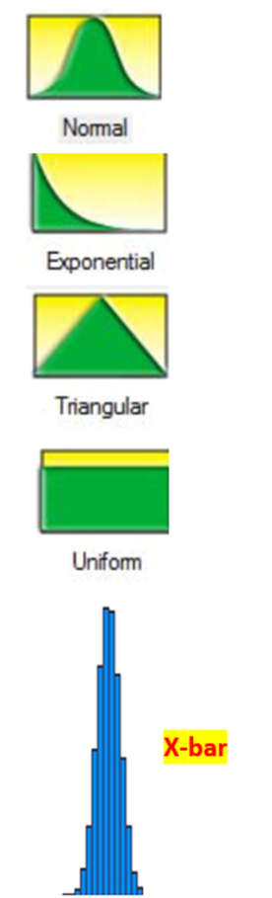
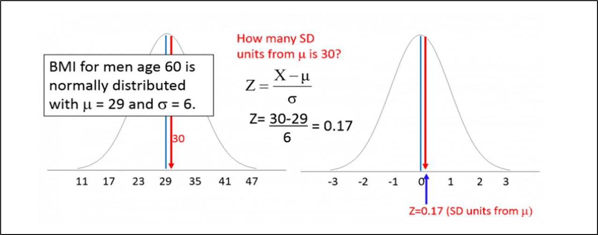
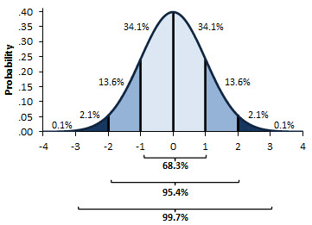
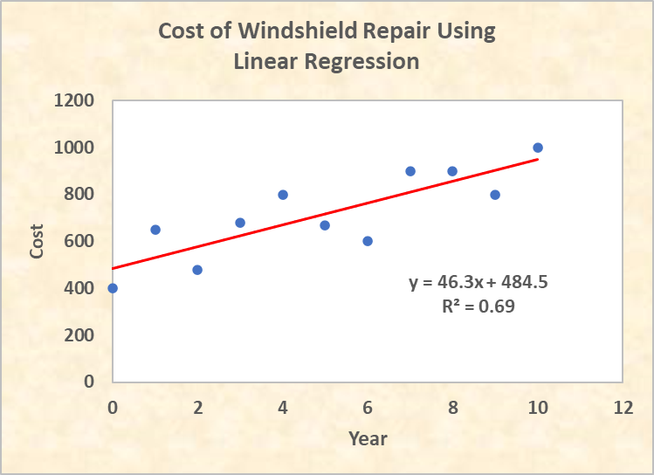
STATISTICS ON A PAGE
Population:
An entire group of people or objects of interest
Sample:
A subset of the population that is studied used to make an inference about the population.
Bias
The sample is not representative of the population.
Inferential Statistics:
Make predictions about the future based on previous data.
Outliers:
Data values that fall outside the expected ranges
Mean, Median, Mode
tells us where the data is centered.
Standard Deviation
tells us how compact or spread out the data is.
Z-score
Central Limit Theorem
Normal Distribution
Linear Regression

